Slide 1
CMPE 220
Class 14
Servers (and client/server applications)
Notes:
Let’s talk about history.
California State Railroad Museum – 1976 - docents worked on original steam engines.

Slide 2
What is an Embedded System?
Wikipedia: An embedded system is a computer system—a combination of a computer processor, computer memory, and input/output peripheral devices—that has a dedicated function within a larger mechanical or electrical system.
Embedded systems control many devices in common use today. Ninety-eight percent of all microprocessors manufactured are used in embedded systems.
Cars | Aircraft | Boats & Ships | Drones | Factory Equipment
Cash Registers | ATMs | Kitchen Appliances | Medical Devices | Kiosks
Home Security Systems | Home Thermostats & Control Systems | Computer Peripherals | TVs & Media Players | Toys

Slide 3
Complex Circuits as Embedded Systems
An “embedded system” may be a very complex circuit – typically designed using a Hardware Definition Language (HDL) – which is capable of performance advanced algorithmic actions.
For purposes of this class, that is not what we are discussing.
By embedded system, we mean a recognizable “computer,” with a processor, memory, and I/O capabilities, executing software that resides in memory.

Slide 4
Why Use Embedded Systems?
Faster and cheaper to develop (standard computers & software, rather than custom hardware).
More flexible: problems can be fixed and features added with software updates.
May be cheaper to manufacture (mass-produced, off-the-shelf computer chips rather than low-volume custom circuits).

Slide 5
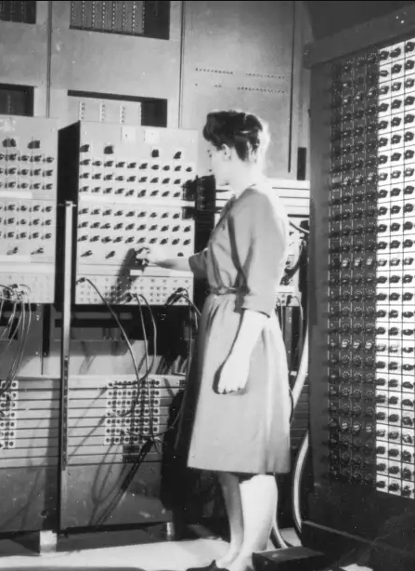
History
One of the earliest mass-produced embedded systems was the Autonetics D-17 guidance computer for the Minuteman missile, released in 1961.
Just as the ENIAC in 1945, which was delivered to the US Army to compute artillery trajectories, a significant advance in computing was driven by military requirements.

Slide 6
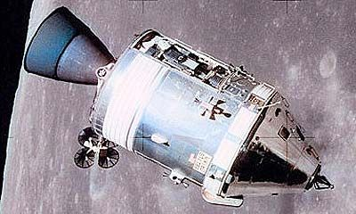
History
A major milestone embedded system: the Apollo Guidance Computer (1965).
Flew both the Apollo Command Module, and the Lunar Excursion Module (1969)
The Apollo space program and moon landing would not have been possible without the development of integrated circuits (ICs) and embedded systems.

Slide 7
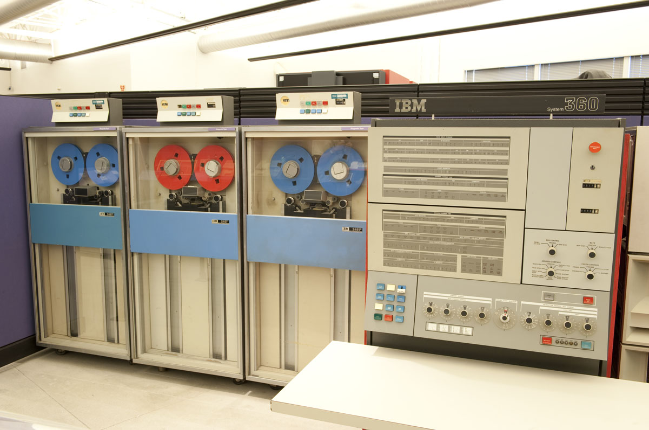
IBM System/360
First released 1964.
Built with discrete Transistor / Transistor Logic (TTL)
“Modern” operating system

Slide 8
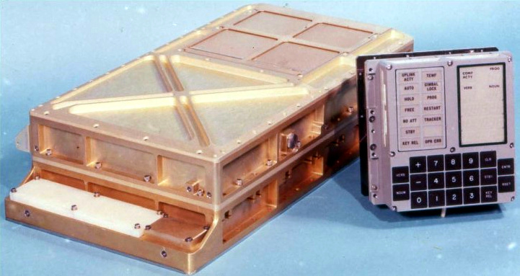
Apollo Guidance Computer
Integrated Circuits
16-bit words
72 KB of ROM for programs
4 KB of RAM
Keypad control interface
Functions:
Displays System Status
Navigates
Flies the Apollo Command Module
Lands the LEM on the moon

Slide 9
More History
In 1968, the first embedded system for a car was released. The Volkswagen 1600 used a microprocessor to control its electronic fuel injection system.
The first microcontroller was developed by Texas Instruments in 1971. The TMS 1000 series, which became commercially available in 1974, contained a 4-bit processor.
In 1987, the first embedded operating system, the real-time VxWorks, was released by Wind River Systems.

Slide 10
Embedded Systems Today
The Internet of Things (IoT) describes the network of physical objects—“things”—that are embedded with sensors, software, and other technologies for the purpose of connecting and exchanging data with other devices and systems over the internet.
These devices range from ordinary household objects to sophisticated industrial tools.
There are an estimated 10 billion devices connected to the Internet today.
A primary reason for IP v6

Slide 11
Embedded System Differences
”Traditional” Computers
General Purpose (GP)
Embedded Systems
Dedicated (Single Purpose)
Different Hardware Architecture & System Characteristics
Different Development Tools
Difference Operating Systems
Different System Software Services (Servers)

Slide 12
Different Architecture / System Characteristics
Specialized Processors
Cheap (mass produced, limited processing power)
Small (simple architecture)
Low power consumption, low heat radiation (slow)
Limited memory
No Memory Management Unit (MMU)
No Disk
OS and Application are loaded from ROM/EPROM (non-volatile memory)
No “traditional” I/O devices
No terminal, card reader, printer
Specialized I/O devices: sensors & controllers (A-to-D and D-to-A)
May have network capabilities (IoT)

Slide 13
Different Development Tools
Cross Development
Cross-Compiler – Runs on a General Purpose (GP) computer; generates assembly code for an embedded computer
Cross-Assembler – Runs on a GP computer, assembles source code for an embedded computer; emits binary object code for that computer
Cross-Linker – Runs on a GP computer; links object files for an embedded computer
Absolute Loader – Runs on embedded computer; loads binary code that was built on a GP computer

Slide 14
Building Embedded System Software
High Level Language Source Code (e.g. C++)
EmSys
Assembly Language Source Code
EmSys Binary Machine Code
Cross Compiler
Cross
Assembler
optional
Embedded System
EmSys
Executable
Code
download
In-Memory
Code
Linker
Loader
Hardware Execution

Slide 15
Different Development Tools - Debugging
Expanded embedded system
A version of the embedded system with expanded capabilities (more memory, terminal interface, disk drive, etc), used for software development
May support a full debugger, and even other development tools, which run natively on the embedded system

Slide 16
Different Development Tools - Debugging
Remote Debugging
Debugging tools run on GP computer.
Debugger talks to a very simply “monitor” program on the embedded computer in order to examine and set memory, and set breakpoints.

Slide 17
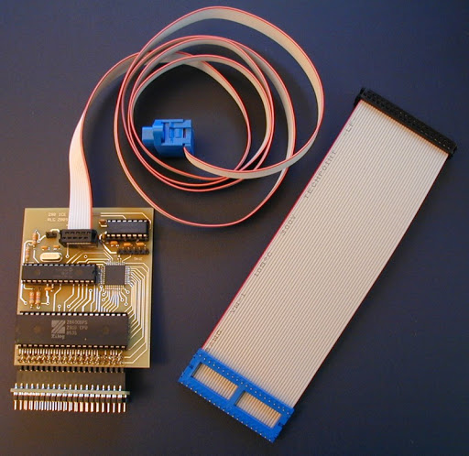
Different Development Tools - Debugging
In-Circuit Emulator (ICE)
A hardware interface connected to a GP computer “plugs in” to a circuit or device, completely replacing the embedded system.
The GP computer supports a full development environment, and emulates the embedded system at a circuit level.

Slide 18
Different Development Tools - Debugging
Joint Test Action Group (JTAG)
Interface capabilities built in to the embedded processor support external access to memory and control signals for purposes of debugging and testing.
Interfaces can be accessed and controlled by a GP computer.
A standard codified by the IEEE in 1990.

Slide 19
Different Development Tools - Debugging
Simulation
A simulator running on a GP computer can execute programs written for the embedded computer.
Interprets the instruction set.
For useful development of embedded systems, may need to simulate I/O devices (sensors, controllers) as well.
Typically used in very “big budget” organizations, such as car companies, aircraft companies, etc.

Slide 20
Languages for Embedded Systems
Assembly Languages
Traditional Languages: C, C++, Python, Ada (DoD)
Specialized Languages: Rust, Go / Golang (Google)

Slide 21
Different Operating Systems
Traditional / General Purpose | Embedded
POSIX (Unix, Linux) Mac OS Windows Android IOS | Embedded Linux Windows 10 IoT VxWorks (Wind River Systems) TinyOS (UC Berkeley, Intel) QNX (Quantum Software Systems) Literally dozens of others

Slide 22
Is a Smartphone an Embedded System?
Low Power Consumption / Low Heat | ✓
No Disk | ✓
Cross-Development Tools | ✓
Limited Memory / No MMU | X
No Traditional I/O Devices | X
Single Purpose | X
Not an embedded system, based primarily on the general-purpose nature of the system.

Slide 23
Embedded Operating Systems
Simplified version of General Purpose Operating System (GPOS) E.g. Embedded Linux, Windows 10 IoT
Familiar
Allows use of existing development tools
Written from the ground up for embedded systems
Modular (an OS framework; add and deleted features as needed)
Efficient
Supports specific needs (e.g. Real Time)

Slide 24
What Does an (Embedded) OS Do?
1 | Process Management | Maybe
2 | Input / Output (I/O) Management | Yes
3 | Memory Management | No
4 | File System Management | No
5 | System Functions and Kernel Mode | Limited
6 | User Interaction | No
7 | Network Communications | Maybe

Slide 25
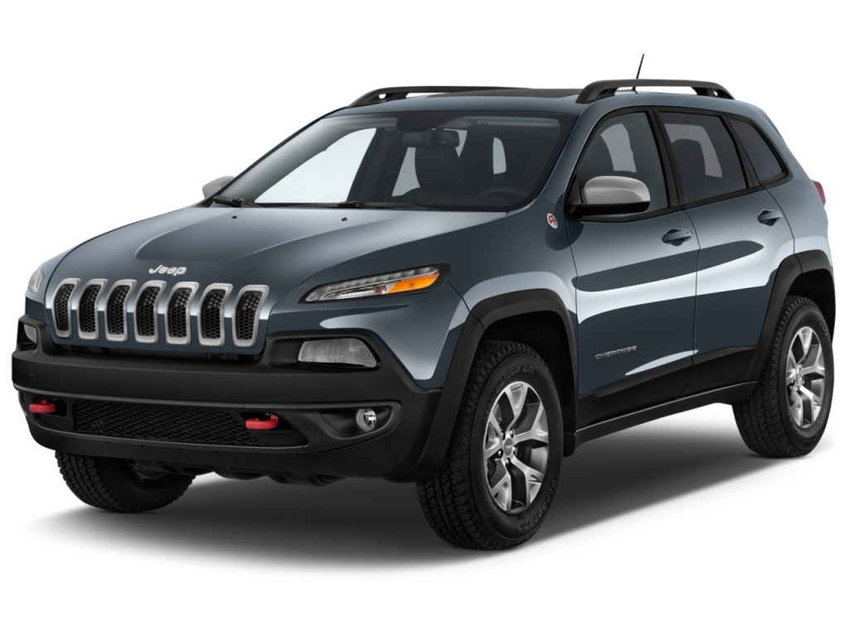
Security
Traditional: Since applications are “friendly,” there are fewer security requirements. The system doesn’t need to protect itself against malicious applications.
Today: IoT opens up the possibility of remote hacking!
In 2015, security researchers demonstrated the ability to take control of a Jeep Cherokee while driving on a highway.
There is no agency that regulates the security of embedded systems.

Slide 26
Real-Time Operating Systems (RTOS)
A real-time operating system (RTOS) is an operating system (OS) intended to serve real-time applications. Real-time applications must respond to inputs within a specified time.
Often a requirement for embedded systems
GP operating systems usually cannot guarantee a response time, for a number of reasons:
Too many processes might be in the process queue
Interrupt processing and process switching may be slow operations
Important code may be “swapped out” on disk
However, there are specialized real-time operating systems for traditional general purpose computers; each of these problems needs to be addressed and overcome by the operating system

Slide 27
Types of RTOS
Asynchronous (Event Response) Responds to asynchronous events. For example, if a proximity alert occurs on a self-driving car, evasive action may be triggered.
Powerful and flexible
Difficult to prove & guarantee real-time response
Continuous (Closed Loop) Constantly monitors inputs and adjusts outputs. For example, monitors temperature sensors and control fans.
Can prove maximum response time by computing longest code path

Slide 28
Further RTOS Classifications
How Rigid are the Real Time Requirements?
Hard: Guaranteed response time.
Flight control systems, robots, drones.
Firm: Range of response times acceptable. Failure to meet the desired response time is undesirable, but not catastrophic.
Assembly line automation.
Soft: Failure to meet desired response times degrades system performance, but consequences are minimal.
Human-facing applications.

Slide 29
RTOS Adaptations
Prioritized Scheduling
Minimized Interrupt Latency
No “blocking” code
No User/Kernel mode switches
Myth: Real Time Systems must be fast (high performance)
Automated assembly line: required response times may be in tens of milliseconds – but must be guaranteed.

Slide 30
Different System Software Services
Tradition, general-purpose computers may run various servers: FTP, email, database, http/web, etc.
Embedded systems may run a “network OS” and support standard network protocols
Surprisingly, many embedded systems run a very light-weight web server
Limited capabilities
Supports http/https protocols
Used to provide a user interface to the system

Slide 31
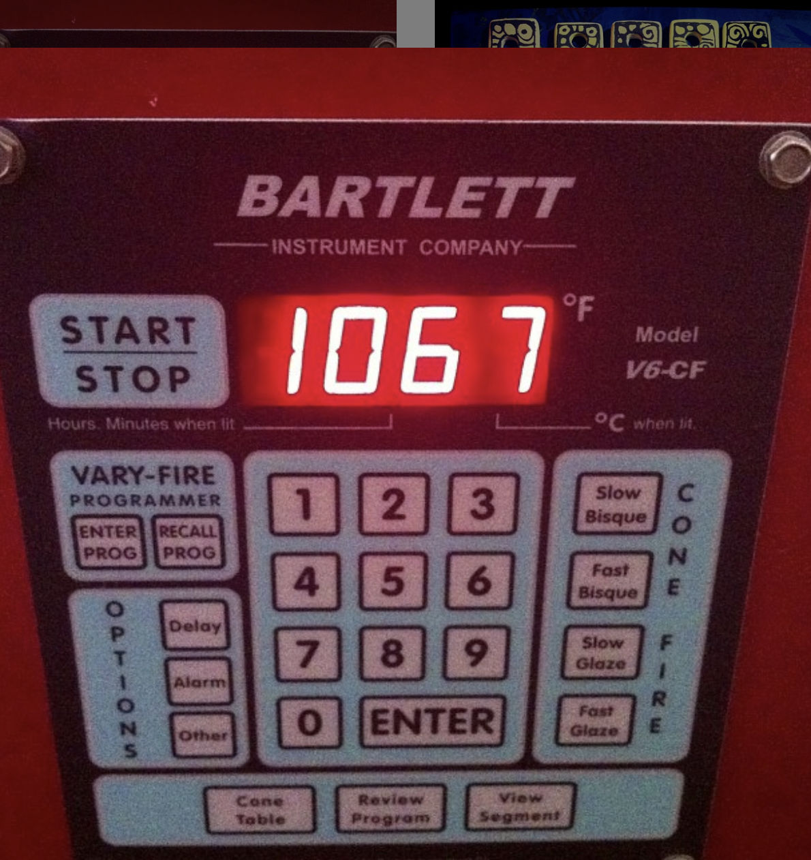
Embedded System Example: Kiln Controller
Allows the user to program a firing cycle: when it starts, how quickly the temperature rises, the max temperature, etc.
A specialized device made by one company (Bartlett) that is found on virtually every kiln sold in the United States, from $1,500 hobbyist models to $200,000 commercial kilns.
Local / manual interface

Slide 32
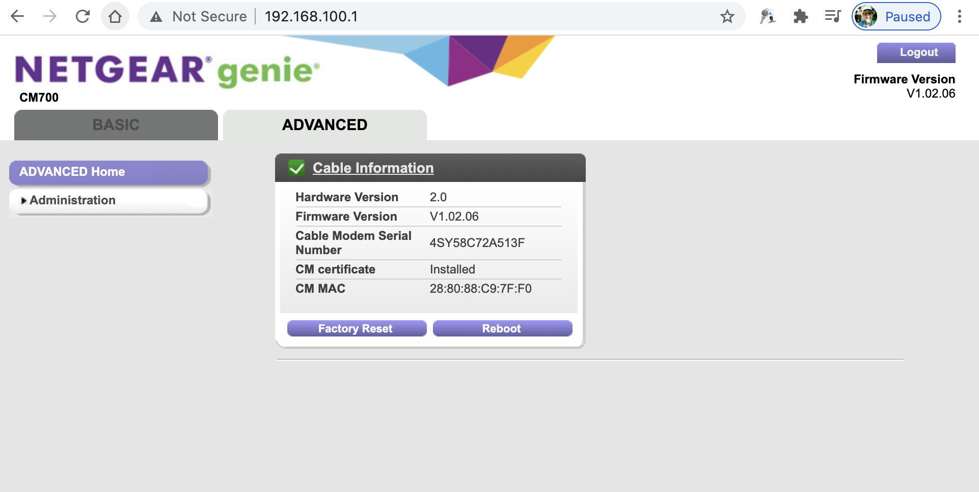
Embedded System Example: Cable Modem
A cable modem & router uses an embedded computer system
Most cable modems & routers run their own web server, so you can manage and configure the router using a web browser

Slide 33
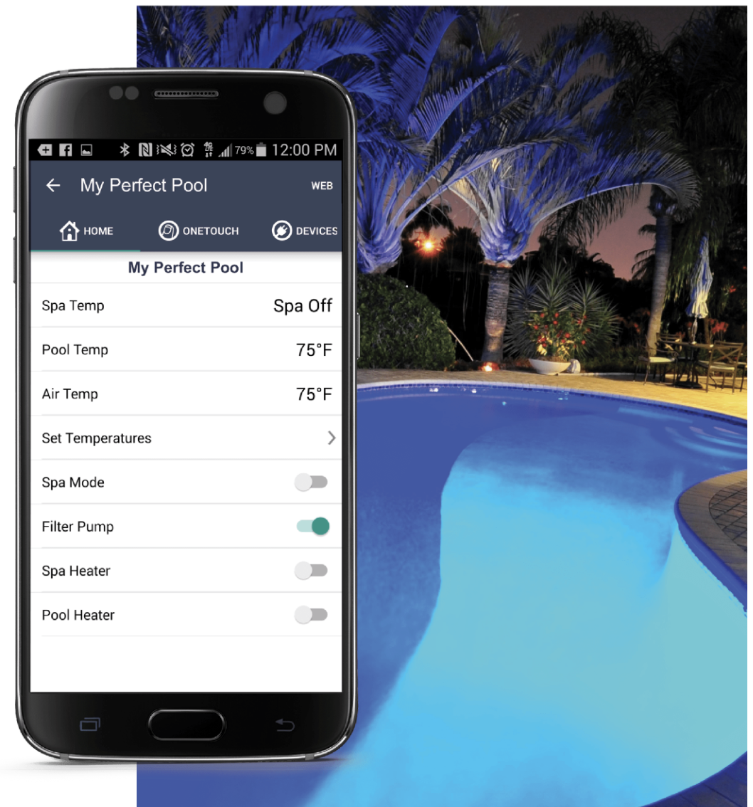
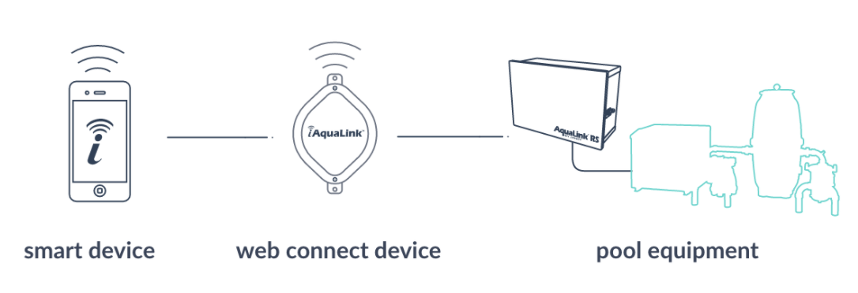
Embedded System Example: Pool Controller
Uses smartphone app or browser to control pool functions remotely
Embedded “network OS,” client-server application, and web server

Slide 34
Embedded Systems in My House
TV(s)
Printer(s)
Cable Modem / Router
Thermostat
Air Purifier
Roomba vacuum
Oven
Microwave
Refrigerator
Dishwasher
Clothes Washer
Clothes Dryer
Bathroom Scale
Pool Controller
Kiln Controller
Sprinkler System Controller
Security System
Video Cameras

Slide 35
Writing Embedded System Applications
Roughly 3-5% of software developers work on embedded systems.
The development process is more cumbersome.
Libraries and system functions are limited.
Programmers need to focus on performance and efficient use of memory.
Programmers may need a deep understanding of specific hardware capabilities.

Slide 36
Arduino
Arduino is a micro-controller* on a board, used for educational purposes and limited commercial development
Developed in 2005 at the Interaction Design Institute Ivrea (IDII) in Ivrea, Italy
No independent OS; library functions are linked into the application program
Inexpensive; can be built into commercial products ($4-25)
* Micro-controller: a very simple, self-contained computer-on-a-chip

Slide 37
Raspberry Pi
Raspberry Pi is a computer on a board, often used in educational environments
Developed in 2012 by Raspberry Pi Foundation and Broadcom
Supports monitor, mouse, and keyboard
Can be interfaced to external sensors and devices to teach some basics of embedded systems programming
A full, general purpose processor and operating system (Linux)
Significant RAM (256MB to 8GB)
No disk
Too expensive to embed in many real-world applications ($35-75)

Slide 38
Alternatives
Many single-board microcontrollers & computers are available for education, development, and embedded applications.
Teensy 3.6
Launchpad MSP430
Netduino N3 Wi-Fi
SparkFun RedBoard Artemis
Silicon Labs Wonder Gecko
RockPi4 Model C
NanoPi NEO3
PocketBeagle
Odroid-XU4
Banana Pi M3

Slide 39
Following a Trend…
Just as with every other technology we’ve look at this semester, embedded systems – and embedded system applications – are becoming more powerful and more complex
At the same time, the systems are becoming smaller, cheaper, and more widespread – meaning more jobs for software developers
Better tools!

Slide 40
For Next Week
Log in to Canvas and complete Assignment 7

Slide 41
Midterm Next Monday
Open Book, Open Notes
We will not use the lockdown browser
A mix of multiple choice, fill-in-the-blanks, and short-answer questions
Bring your laptops!

Slide 42
Next Week: Midterm (Intro)
Historical figures: Grace Hopper, Kathleen Booth, David Wheeler, Dennis Ritchie, Ken Thompson, Edsger Dijkstra, David Patterson
Key dates: first assembler, punched cards, first binary computer, first linker, first command-line shell, make, ASCII / UTF characters, first IDE, structured programming, etc.
What are Unix / Linux / POSIX systems”

Slide 43
Command Line Interfaces
Basic shell commands (cat, ls, cd, pwd) and concept (pipes, I/O redirection)
File permissions and ownership
Makefiles and make rules

Slide 44
Midterm (Architecture)
BCD arithmetic
Character set representations (ASCII, EBCDIC, Unicode, UTF-8, UTF-16)
Floating point representations
Addressing modes (immediate, displacement, indirect, register, stack)
RISC versus CISC
Pipelining
Microprogramming
The SIC and SIC/XE instruction set
Short programs

Slide 45
Machine (Architectural Directions)
Integrating functions onto processor chip
Shifting function to MMU
Quantum computers

Slide 46
Midterm (The Software Build Cycle)
High Level Language Source Code (e.g. C++)
Assembly Language Source Code
Binary Machine Code
Compiler
Assembler
optional
Executable
Code
In-Memory
Code
Linker
Loader
Hardware Execution

Slide 47
Midterm (The Software Development Cycle)
Two pass and single pass assemblers
Relocating linkers
Dynamic libraries
Absolute versus relocating loaders
IDEs
Smart editors
Version control
Debuggers & breakpoints
Macro Languages and Macro-Processors

Slide 48
Software Development Concepts
Structured Programming
Sequence
Selection
Iteration
Pseudocode

Slide 49
Compilers
Scanning (lexical processing)
Finite State Machines
Parsing (syntactic processing)
Code Generation
Optimization

Slide 50
Operating Systems
Process Management
Interprocess Communications
Input / Output (I/O) Management
Memory Management
File System Management
System Functions and Kernel Mode
User Interaction – (maybe)
Network Management

Slide 51
OS Details
Process Management
Interprocess Communications
Process Control Blocks (PCBs)
Schedulers
Dispatchers
Input / Output (I/O) Management
I/O Control Blocks
I/O Wait States
Memory Management
Virtual Memory
Memory Management Units (MMUs)

Slide 52
Operating Systems
File System Management
Directories
File system cleanup
System Functions and Kernel Mode
User mode versus kernel mode
Context switching
User Interaction – (maybe)
Shells
Windowing systems

Slide 53
Operating Systems
Network Management
Protocols
Ports

Slide 54
Types of Operating Systems
Distributed Operating Systems
Network Operating Systems
Cloud Operating Systems
Object Oriented Operating Systems

Slide 55
Client-Server Applications
OSI versus TCP/IP Stack
Protocols
IP addressing
IP v4 versus IP v6
Ports
UDP, TCP, HTTP, HTTPS
Client-Server Applications
FTP
DNS lookup
Web Servers
Web Services and Applications
Email

